Slide 1
Multivariate Regression
Chapter 14
Chap 14-<number>

Slide 2
Learning Objectives
In this chapter, you learn:
How to develop a multiple regression model
How to interpret the regression coefficients
How to determine which independent variables to include in the regression model
How to determine which independent variables are more important in predicting a dependent variable
Chap 14-<number>

Slide 3
The Multiple Regression Model
Idea: Examine the linear relationship between
1 dependent (Y) & 2 or more independent variables (X_{i})
Multiple Regression Model with k Independent Variables:
Y-intercept
Population slopes
Random Error
Chap 14-<number>

Slide 4
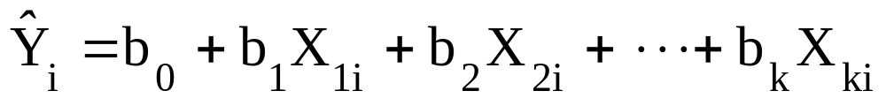
Multiple Regression Equation
The coefficients of the multiple regression model are estimated using sample data
Multiple regression equation with k independent variables:
Estimated
(or predicted)
value of Y
Estimated
intercept
Estimated slope coefficients
In this chapter we will use Excel to obtain the regression slope coefficients and other regression summary measures.
Chap 14-<number>

Slide 5
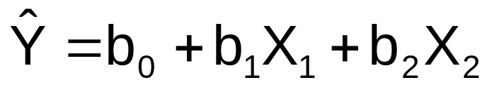
Multiple Regression Equation
(continued)
Two variable model
Y
Slope for variable X₁
X₂
Slope for variable X₂
X₁
Chap 14-<number>

Slide 6

Example:
2 Independent Variables
A distributor of frozen dessert pies wants to evaluate factors thought to influence demand
  Dependent variable: Pie sales (units per week)
  Independent variables: Price (in $)
    Advertising ($100’s)
Data are collected for 15 weeks
Chap 14-<number>

Slide 7
Pie Sales Example
Week | Pie Sales | Price ($) | Advertising ($100s)
1 | 350 | 5.50 | 3.3
2 | 460 | 7.50 | 3.3
3 | 350 | 8.00 | 3.0
4 | 430 | 8.00 | 4.5
5 | 350 | 6.80 | 3.0
6 | 380 | 7.50 | 4.0
7 | 430 | 4.50 | 3.0
8 | 470 | 6.40 | 3.7
9 | 450 | 7.00 | 3.5
10 | 490 | 5.00 | 4.0
11 | 340 | 7.20 | 3.5
12 | 300 | 7.90 | 3.2
13 | 440 | 5.90 | 4.0
14 | 450 | 5.00 | 3.5
15 | 300 | 7.00 | 2.7
Multiple regression equation:
Sales = b₀ + b₁ (Price)
+ b₂ (Advertising)
Chap 14-<number>

Slide 8
Excel Multiple Regression Output
Regression Statistics
Multiple R | 0.72213
R Square | 0.52148
Adjusted R Square | 0.44172
Standard Error | 47.46341
Observations | 15
ANOVA | df | SS | MS | F | Significance F
Regression | 2 | 29460.027 | 14730.013 | 6.53861 | 0.01201
Residual | 12 | 27033.306 | 2252.776
Total | 14 | 56493.333
 | Coefficients | Standard Error | t Stat | P-value | Lower 95% | Upper 95%
Intercept | 306.52619 | 114.25389 | 2.68285 | 0.01993 | 57.58835 | 555.46404
Price | -24.97509 | 10.83213 | -2.30565 | 0.03979 | -48.57626 | -1.37392
Advertising | 74.13096 | 25.96732 | 2.85478 | 0.01449 | 17.55303 | 130.70888
Chap 14-<number>

Slide 9
The Multiple Regression Equation
where
Sales is in number of pies per week
Price is in $
Advertising is in $100’s.
b₁ = -24.975: sales will decrease, on average, by 24.975 pies per week for each $1 increase in selling price, net of the effects of changes due to advertising
b₂ = 74.131: sales will increase, on average, by 74.131 pies per week for each $100 increase in advertising, net of the effects of changes due to price
Chap 14-<number>

Slide 10
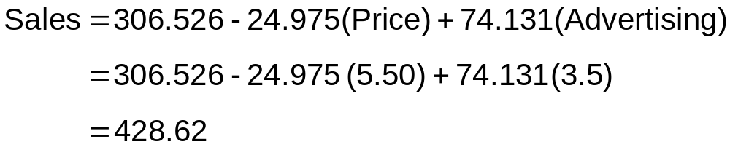
Using The Equation to Make Predictions
Predict sales for a week in which the selling price is $5.50 and advertising is $350:
Note that Advertising is in $100s, so $350 means that X₂ = 3.5
Predicted sales is 428.62 pies
Chap 14-<number>

Slide 11
Examples
#14.3
#14.6
Chap 14-<number>

Slide 12
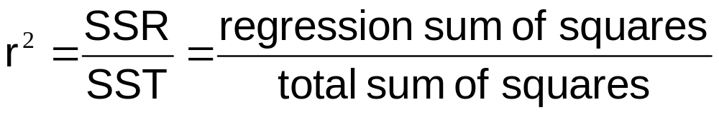
Coefficient of
Multiple Determination
Reports the proportion of total variation in Y explained by all X variables taken together
Chap 14-<number>

Slide 13
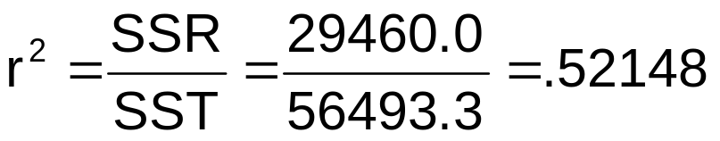
Multiple Coefficient of
Determination In Excel
Regression Statistics
Multiple R | 0.72213
R Square | 0.52148
Adjusted R Square | 0.44172
Standard Error | 47.46341
Observations | 15
ANOVA | df | SS | MS | F | Significance F
Regression | 2 | 29460.027 | 14730.013 | 6.53861 | 0.01201
Residual | 12 | 27033.306 | 2252.776
Total | 14 | 56493.333
 | Coefficients | Standard Error | t Stat | P-value | Lower 95% | Upper 95%
Intercept | 306.52619 | 114.25389 | 2.68285 | 0.01993 | 57.58835 | 555.46404
Price | -24.97509 | 10.83213 | -2.30565 | 0.03979 | -48.57626 | -1.37392
Advertising | 74.13096 | 25.96732 | 2.85478 | 0.01449 | 17.55303 | 130.70888
52.1% of the variation in pie sales is explained by the variation in price and advertising
Chap 14-<number>

Slide 14
Adjusted r²
r² never decreases when a new X variable is added to the model
  This can be a disadvantage when comparing models
What is the net effect of adding a new variable?
  We lose a degree of freedom when a new X variable is added
  Did the new X variable add enough explanatory power to offset the loss of one degree of freedom?
Chap 14-<number>

Slide 15
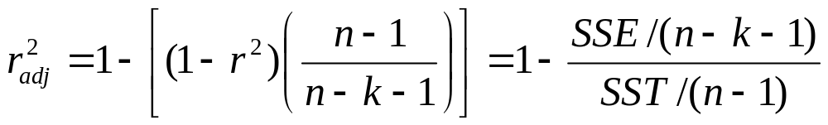
Adjusted r²
(continued)
Shows the proportion of variation in Y explained by all X variables adjusted for the number of X variables used
  (where n = sample size, k = number of independent variables)
  Penalizes excessive use of unimportant independent variables
  Smaller than r²
  Useful in comparing among models
Chap 14-<number>

Slide 16
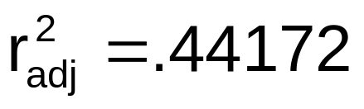
Adjusted r² in Excel
Regression Statistics
Multiple R | 0.72213
R Square | 0.52148
Adjusted R Square | 0.44172
Standard Error | 47.46341
Observations | 15
ANOVA | df | SS | MS | F | Significance F
Regression | 2 | 29460.027 | 14730.013 | 6.53861 | 0.01201
Residual | 12 | 27033.306 | 2252.776
Total | 14 | 56493.333
 | Coefficients | Standard Error | t Stat | P-value | Lower 95% | Upper 95%
Intercept | 306.52619 | 114.25389 | 2.68285 | 0.01993 | 57.58835 | 555.46404
Price | -24.97509 | 10.83213 | -2.30565 | 0.03979 | -48.57626 | -1.37392
Advertising | 74.13096 | 25.96732 | 2.85478 | 0.01449 | 17.55303 | 130.70888
44.2% of the variation in pie sales is explained by the variation in price and advertising, taking into account the sample size and number of independent variables
Chap 14-<number>

Slide 17
Is the Model Significant?
F Test for Overall Significance of the Model
Shows if there is a linear relationship between all of the X variables considered together and Y
Use F-test statistic
Hypotheses:
  H₀: β₁ = β₂ = … = β_{k} = 0 (no linear relationship)
  H₁: at least one β_{i} ≠ 0 (at least one independent
  variable affects Y)
Chap 14-<number>

Slide 18
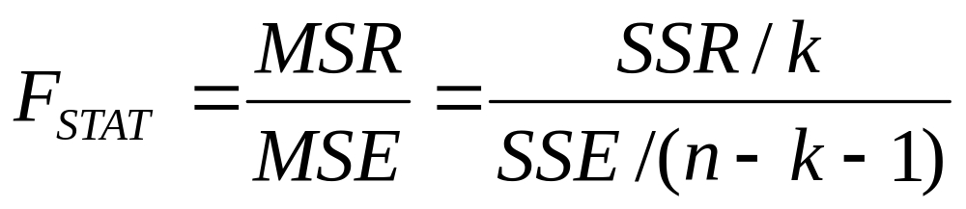
F Test for Overall Significance
Test statistic:
where F_{STAT} has numerator d.f. = k and
denominator d.f. = (n – k - 1)
Chap 14-<number>

Slide 19
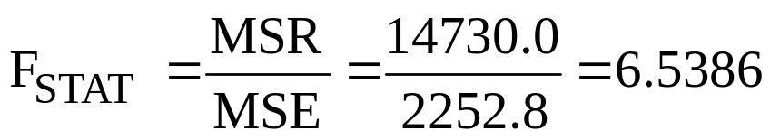
F Test for Overall Significance In Excel
(continued)
Regression Statistics
Multiple R | 0.72213
R Square | 0.52148
Adjusted R Square | 0.44172
Standard Error | 47.46341
Observations | 15
ANOVA | df | SS | MS | F | Significance F
Regression | 2 | 29460.027 | 14730.013 | 6.53861 | 0.01201
Residual | 12 | 27033.306 | 2252.776
Total | 14 | 56493.333
 | Coefficients | Standard Error | t Stat | P-value | Lower 95% | Upper 95%
Intercept | 306.52619 | 114.25389 | 2.68285 | 0.01993 | 57.58835 | 555.46404
Price | -24.97509 | 10.83213 | -2.30565 | 0.03979 | -48.57626 | -1.37392
Advertising | 74.13096 | 25.96732 | 2.85478 | 0.01449 | 17.55303 | 130.70888
With 2 and 12 degrees of freedom
P-value for the F Test
Chap 14-<number>

Slide 20
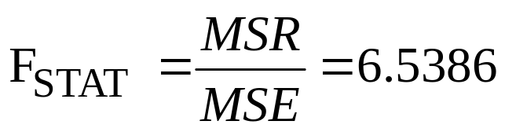
F Test for Overall Significance
(continued)
H₀: β₁ = β₂ = 0
H₁: β₁ and β₂ not both zero
α = .05
df₁= 2 df₂ = 12
Test Statistic:
Decision:
Conclusion:
Critical Value:
F_{0.05} = 3.885
Since F_{STAT} test statistic is in the rejection region (p-value < .05), reject H₀
α = .05
0
F
There is evidence that at least one independent variable affects Y
Do not
reject H₀
Reject H₀
F_{0.05} = 3.885
Chap 14-<number>

Slide 21
Examples
#14.10
#14.16
Chap 14-<number>

Slide 22
Are Individual Variables Significant?
Use t tests of individual variable slopes
Shows if there is a linear relationship between the variable X_{j} and Y holding constant the effects of other X variables
Hypotheses:
  H₀: β_{j} = 0 (no linear relationship)
  H₁: β_{j} ≠ 0 (linear relationship does exist
  between X_{j} and Y)
Chap 14-<number>

Slide 23
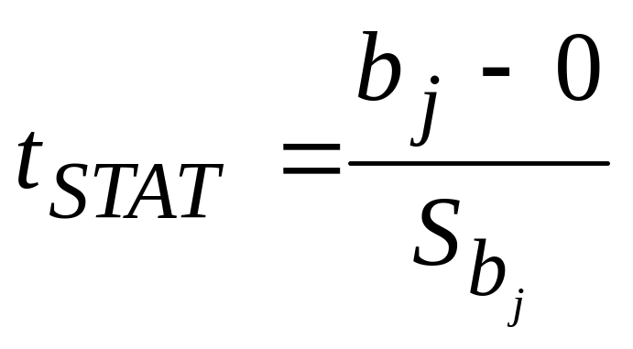
Are Individual Variables Significant?
(continued)
  H₀: β_{j} = 0 (no linear relationship)
  H₁: β_{j} ≠ 0 (linear relationship does exist
  between X_{j} and Y)
  Test Statistic:
  (df = n – k – 1)
Chap 14-<number>

Slide 24
Are Individual Variables Significant? Excel Output
(continued)
Regression Statistics
Multiple R | 0.72213
R Square | 0.52148
Adjusted R Square | 0.44172
Standard Error | 47.46341
Observations | 15
ANOVA | df | SS | MS | F | Significance F
Regression | 2 | 29460.027 | 14730.013 | 6.53861 | 0.01201
Residual | 12 | 27033.306 | 2252.776
Total | 14 | 56493.333
 | Coefficients | Standard Error | t Stat | P-value | Lower 95% | Upper 95%
Intercept | 306.52619 | 114.25389 | 2.68285 | 0.01993 | 57.58835 | 555.46404
Price | -24.97509 | 10.83213 | -2.30565 | 0.03979 | -48.57626 | -1.37392
Advertising | 74.13096 | 25.96732 | 2.85478 | 0.01449 | 17.55303 | 130.70888
t Stat for Price is t_{STAT} = -2.306, with p-value .0398
t Stat for Advertising is t_{STAT} = 2.855, with p-value .0145
Chap 14-<number>

Slide 25
Inferences about the Slope: t Test Example
From the Excel output:
H₀: β_{j} = 0
H₁: β_{j} ≠ 0
For Price t_{STAT} = -2.306, with p-value .0398
For Advertising t_{STAT} = 2.855, with p-value .0145
d.f. = 15-2-1 = 12
= .05
t_{α/2} = 2.1788
The test statistic for each variable falls in the rejection region (p-values < .05)
Decision:
Conclusion:
α/2=.025
α/2=.025
Reject H₀ for each variable
There is evidence that both Price and Advertising affect pie sales at α = .05
Reject H₀
Do not reject H₀
Reject H₀
-t_{α/2}
t_{α/2}
0
-2.1788
2.1788
Chap 14-<number>

Slide 26
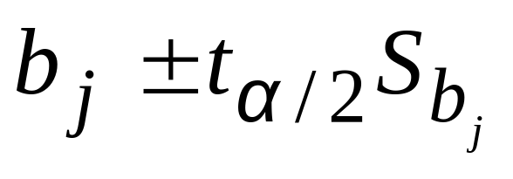
Confidence Interval Estimate for the Slope
Confidence interval for the population slope β_{j}
where t has
(n – k – 1) d.f.
 | Coefficients | Standard Error
Intercept | 306.52619 | 114.25389
Price | -24.97509 | 10.83213
Advertising | 74.13096 | 25.96732
Here, t has
(15 – 2 – 1) = 12 d.f.
Example: Form a 95% confidence interval for the effect of changes in price (X₁) on pie sales:
-24.975 ± (2.1788)(10.832)
So the interval is (-48.576 , -1.374)
(This interval does not contain zero, so price has a significant effect on sales)
Chap 14-<number>

Slide 27
Confidence Interval Estimate for the Slope
(continued)
Confidence interval for the population slope β_{j}
 | Coefficients | Standard Error | … | Lower 95% | Upper 95%
Intercept | 306.52619 | 114.25389 | … | 57.58835 | 555.46404
Price | -24.97509 | 10.83213 | … | -48.57626 | -1.37392
Advertising | 74.13096 | 25.96732 | … | 17.55303 | 130.70888
Example: Excel output also reports these interval endpoints:
Weekly sales are estimated to be reduced by between 1.37 to 48.58 pies for each increase of $1 in the selling price, holding the effect of advertising constant
Chap 14-<number>

Slide 28
Examples
## 14.25, 14.28
Chap 14-<number>

Slide 29
Testing Portions of the Multiple Regression Model
Contribution of a Single Independent Variable X_{j}
SSR(X_{j} | all variables except X_{j})
  = SSR (all variables) – SSR(all variables except X_{j})
  This is extra Sum of Squares attributed to X_{j}
  Measures the contribution of X_{j} in explaining the total variation in Y (SST)
Chap 14-<number>

Slide 30
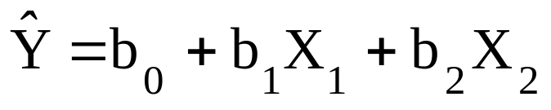
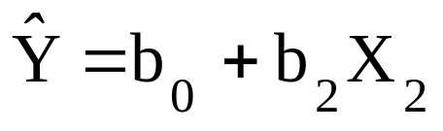
Testing Portions of the Multiple Regression Model
(continued)
Contribution of a Single Independent Variable X_{j}, assuming all other variables are already included
(consider here a 2-variable model):
SSR(X₁ | X₂)
  = SSR (all variables) – SSR(X₂)
From ANOVA section of regression for
From ANOVA section of regression for
Measures the contribution of X₁ in explaining SST
Chap 14-<number>

Slide 31
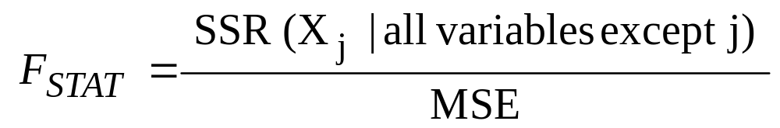
The Partial F-Test Statistic
Consider the hypothesis test:
H₀: variable X_{j} does not significantly improve the model after all
other variables are included
H₁: variable X_{j} significantly improves the model after all other
variables are included
Test using the F-test statistic:
  (with 1 and n-k-1 d.f.)
Chap 14-<number>

Slide 32
Testing Portions of Model: Example
Example: Frozen dessert pies
Test at the α = .05 level to determine whether the price variable significantly improves the model given that advertising is included
Chap 14-<number>

Slide 33
Testing Portions of Model: Example
(continued)
H₀: X₁ (price) does not improve the model
with X₂ (advertising) included
H₁: X₁ does improve model
α = .05, df = 1 and 12
F_{0.05} = 4.75
(For X₁ and X₂)
(For X₂ only)
ANOVA
 | df | SS | MS
Regression | 2 | 29460.02687 | 14730.01343
Residual | 12 | 27033.30647 | 2252.775539
Total | 14 | 56493.33333
ANOVA
 | df | SS
Regression | 1 | 17484.22249
Residual | 13 | 39009.11085
Total | 14 | 56493.33333
Chap 14-<number>

Slide 34
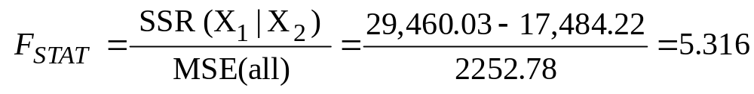
Testing Portions of Model: Example
(continued)
(For X₁ and X₂)
(For X₂ only)
ANOVA
 | df | SS | MS
Regression | 2 | 29460.02687 | 14730.01343
Residual | 12 | 27033.30647 | 2252.775539
Total | 14 | 56493.33333
ANOVA
 | df | SS
Regression | 1 | 17484.22249
Residual | 13 | 39009.11085
Total | 14 | 56493.33333
Conclusion: Since F_{STAT} = 5.316 > F_{0.05} = 4.75 Reject H₀; Adding X₁ does improve model
Chap 14-<number>

Slide 35
Testing Portions of Model: Example
(continued)
H₀: X₂ (advertising) does not improve the
model with X₁ (price) included
H₁: X₂ does improve model
α = .05, df = 1 and 12
F_{0.05} = 4.75
(For X₁ and X₂)
(For X₁ only)
ANOVA
 | df | SS | MS
Regression | 2 | 29460.02687 | 14730.01343
Residual | 12 | 27033.30647 | 2252.775539
Total | 14 | 56493.33333
ANOVA
 | df | SS
Regression | 1 | 11100.43803
Residual | 13 | 45392.8953
Total | 14 | 56493.33333
Chap 14-<number>

Slide 36
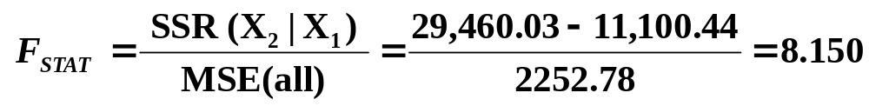
Testing Portions of Model: Example
(continued)
(For X₁ and X₂)
(For X₁ only)
ANOVA
 | df | SS | MS
Regression | 2 | 29460.02687 | 14730.01343
Residual | 12 | 27033.30647 | 2252.775539
Total | 14 | 56493.33333
ANOVA
 | df | SS
Regression | 1 | 11100.43803
Residual | 13 | 45392.8953
Total | 14 | 56493.33333
Conclusion: Since F_{STAT} = 8.150 > F_{0.05} = 4.75 Reject H₀; Adding X₂ does improve model
Chap 14-<number>

Slide 37
Examples
## 14.32a, 14.36a
Chap 14-<number>

Slide 38
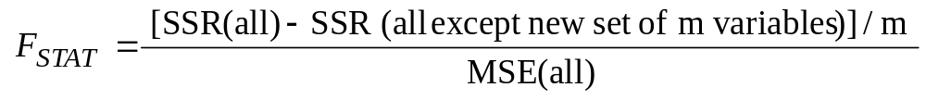
Simultaneous Contribution of Independent Variables
Use partial F test for the simultaneous contribution of multiple variables to the model
  Let m variables be an additional set of variables added simultaneously
  To test the hypothesis that the set of m variables improves the model:
(where F_{STAT} has m and n-k-1 d.f.)
Chap 14-<number>

Slide 39
Model Building
Goal is to develop a model with the best set of independent variables
Stepwise regression procedure
  Provide evaluation of alternative models as variables are added and deleted, with partial F tests.
Best-subset approach
  Try all combinations and select the best using the highest adjusted r² and lowest standard error
Chap 15-<number>

Slide 40
Stepwise Regression
Idea: develop the least squares regression equation in steps, adding one independent variable at a time and evaluating whether existing variables should remain or be removed
Evaluate significance of newly added variables by partial F tests
Chap 15-<number>

Slide 41
Best Subsets Regression
Idea: estimate all possible regression equations using all possible combinations of independent variables
Choose the best fit by looking for the highest adjusted r² and lowest standard error
Chap 15-<number>

Slide 42
Chapter Summary
In this chapter we discussed
The multiple regression model
Testing the significance of the multiple regression model
Adjusted r²
Testing individual regression coefficients
Testing portions of the regression model
Chap 14-<number>

